Slide 1

Bank term deposit
Presented by James Murage

Slide 2
Direct Marketing Campaigns for Bank Term Deposits
Introduction
This dataset, titled Direct Marketing Campaigns for Bank Term Deposits, is a collection of data related to the direct marketing campaigns conducted by a Portuguese banking institution. These campaigns primarily involved phone calls with customers, and the objective was to determine whether or not a customer would subscribe to a term deposit offered by the bank.

Slide 3
About this dataset
The dataset contains various features
Age
Job
Marital
Education
Default – credit
Balance – customer’s account balance
Housing Loan
Contact Communication Type
Day
Duration
Campaign Contacts Count

Slide 4
Objectives of the project
Objective is to visualize how customers subscribe to a term deposit based on these various features. By analyzing historical data on successful and unsuccessful subscription outcomes, patterns can be identified which can help predict future subscription behavior.

Slide 5
Data understanding
Each record (row) in this dataset represents a customer.
Each feature (column) in this dataset is some attribute of that customer. You can view the file `data/data_description.txt` in this repository for a full explanation of all variables in this dataset — 12 columns in total.
The focus is on the following features: **Age**: `Numerical values between 19 and 90` **Job**: `Managenent, blue-collar, other` **Marital** : `married, single, other` **Education**: `secondary, tertiary, other` **Balance**: `Numerical values ` **Housing**: `Categorical data true, false` **Loan**: `Categorical data true, false`

Slide 6
1. Importing libraries
The following python libraries are useful in the project:
import pandas as pd
import numpy as np
import statistics as sts
import seaborn as sns
import matplotlib.pyplot as plt
%matplotlib inline

Slide 7
Using pandas library to read the csv files
Using pandas to open the csv files using the paths `data/bank_main_file.csv` and `data/bank_sub_file.csv` as df1 and df2. respectively
Code
df1=pd.read_csv('data/bank_main_file.csv')
df2=pd.read_csv('data/bank_sub_file.csv')

Slide 8
Checking whether the fills were loaded correctly:
Using the assert method to confirm that the data have been loaded correctly
# Check that df is a dataframe
assert type(df1) == pd.DataFrame
assert type(df2) == pd.DataFrame
# Check that there are the correct number of rows
assert df1.shape[0] == 4521
assert df2.shape[0] == 11162
# Check that there are the correct number of columns
# (if this crashes, make sure you specified `index_col=0`)
assert df1.shape[1] == 17
assert df2.shape[1] == 17
Absence of errors confirms that the files were correctly loaded.

Slide 9
Inspecting the contents of the dataframe
Printing the shape of the datasets to check the number of column and rows for each dataset.
print(f'df1 shape: {df1.shape}')
print(f'df2 shape:{df2.shape}')
The following output is observed:
df1 shape: (4521, 17)
df2 shape:(11162, 17)
Its observed that df1 contains 4521 rows and 17 columns while df2 contains 11162 rows and 17 columns

Slide 10
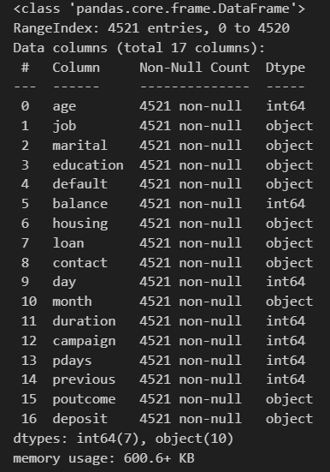
Inspecting df1 data frame information
# dataframe df1 information summary
df1.info()
The figure shows that all columns in all the rows were populated., 7 columns wee of datatype integer while 10 were strings
The file occupies 600 kbs

Slide 11
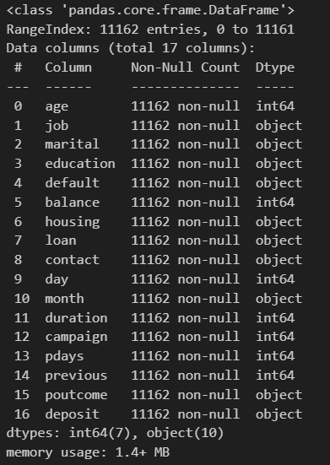
Inspecting df2 data frame information
# dataframe df2 information summary
df2.info()
The figure shows that all columns in all the rows were populated., 7 columns wee of datatype integer while 10 were strings
The file occupies 1.4 Mbs

Slide 12
2. Combining the dataframes
Merging the two dataframes df1 wit df2 to form a new dataframe df3:
df3 = df1.merge(df2, how="outer")
Checking the shape of df3
df3.shape
The shape of df3 - (14583 rows and 17 columns)

Slide 13
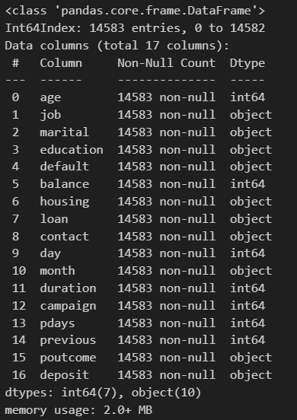
Inspecting df3 data frame information
# dataframe df3 information summary
df2.info()
The figure shows that all columns (17 columns) in all the rows (14583 rows) were populated., 7 columns were of datatype integer while 10 were strings
The file occupies 2.0+ Mbs

Slide 14
Exploring data distributions
Using histograms showing the distributions o:
`Age`
`Job`
`marital`
`education`
`balance`
`housing`
`loan`

Slide 15
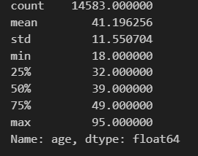
a) Age
The age of the customer.
# age statistical analysis
df3['age'].describe()
The age statistics shows that the mean age of the customers is 41years with the oldest being 95 years and the youngest being 18 years.

Slide 16
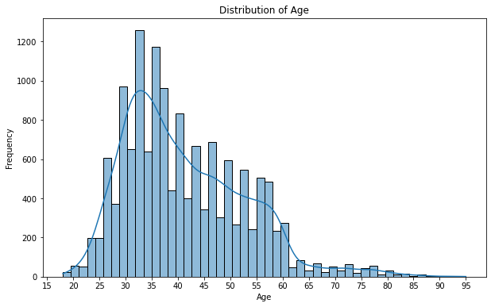
Histogram for age feature
The histogram plot shows that:
Majority of customers were of the age between 30 years and 58 years
The most prevalent age range is [30 - 47]

Slide 17
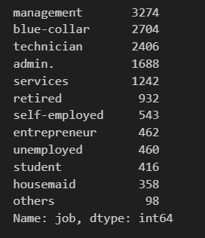
b) Job
The employment status of the customers
# job analysis
df3['job'].value_counts()
Majority of customers were in management job category, followed by blue-collar and technicians.

Slide 18
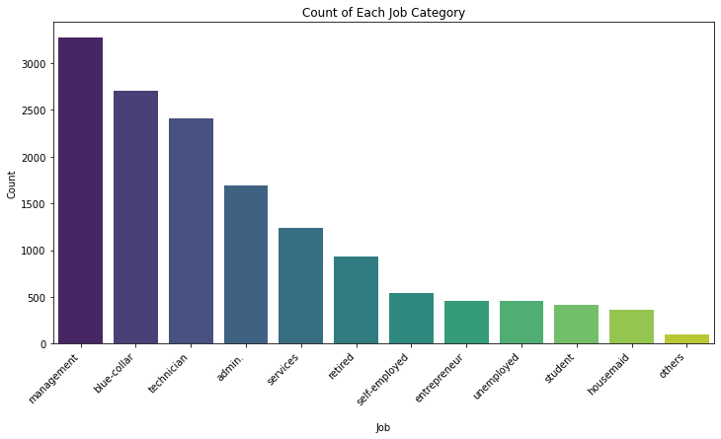
Histogram for Job feature
The histogram plot shows that:
Majority of customers were in management job category, followed by blue-collar and technicians.

Slide 19
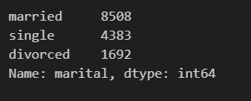
c) Marital status
The marital status of the customers
df3[‘marital'].value_counts()
Majority of customers were in married.

Slide 20
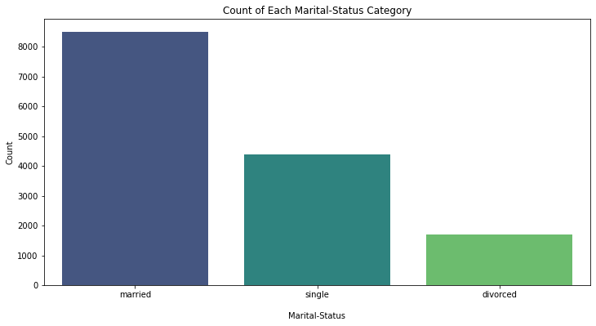
Histogram for Job feature
The histogram plot shows that:
Majority of customers married, followed by the singles

Slide 21
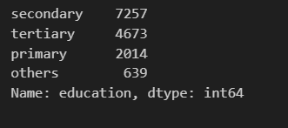
d) Education Level
The education level of the customers
df3[‘education'].value_counts()
Majority of customers had attained secondary education.

Slide 22
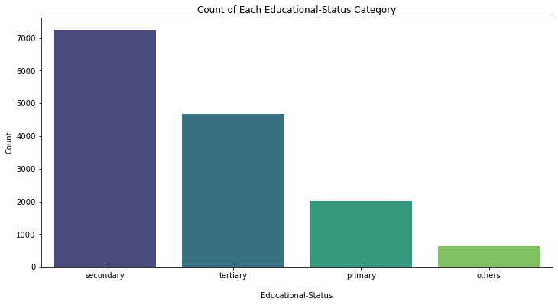
Histogram for Job feature
The histogram plot shows that:
Majority of customers had attained the secondary level education followed with tertiary level.

Slide 23

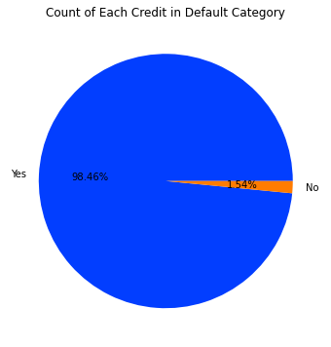
e) Credit in default feature
Whether the customer has credit in default or not
df3[‘default'].value_counts()
A pie plot shows that:
"no" values is very poor, the default column may not be useful thus it can be ignored.

Slide 24
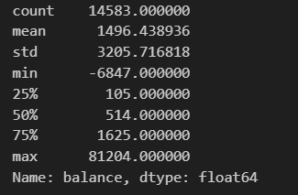
f) Bank balances for customers
The balances in the customer’s account.
df3['balance'].describe()
Statistical description of the balances shows that the average account balance for the customers is 1496 which includes loans as negative values.

Slide 25
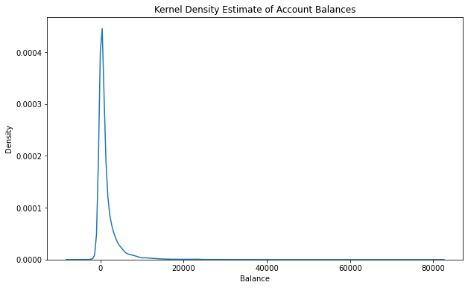
Plotting a density graph
The graph shows a negatively skewed sketch.
This indicates presence of extreme data points (outliers which can be remover)

Slide 26
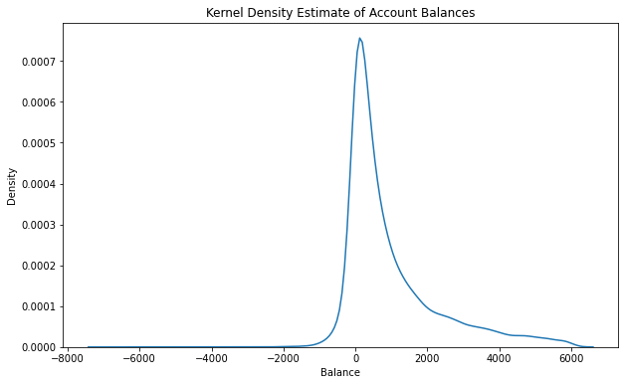
Plotting a density graph without upper outliers
The density graph of balances without the upper side outliers (Above the 95 percentile).

Slide 27
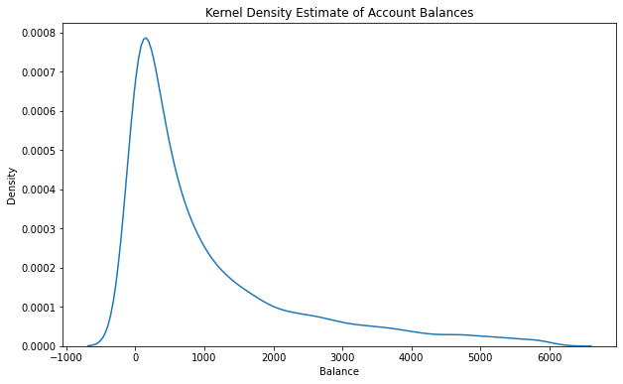
Plotting a density graph without lower outliers
The density graph of balances without the lower side outliers (below the 25 percentile).

Slide 28
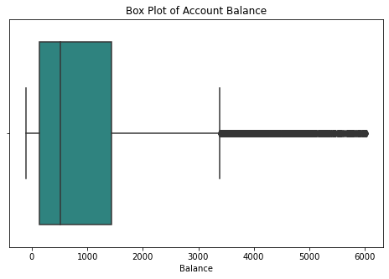
Representing the cleaned balance column on a boxplot

Slide 29

Now, print out the mean, median, and standard deviation:
Using the statistic methods in python we can obtain the mean, median and standard deviation for the cleaned balance column.
The customers have a average account balance of 1496.43 the distribution has a median of 514 and a standard deviation of 3205.71

Slide 30
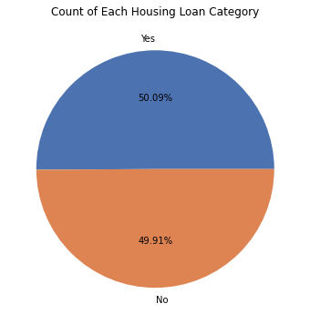

g) Housing loan Feature
Whether the customer has a housing loan or not.
df3['housing'].value_counts()
The results indicate an almost equal shares.

Slide 31
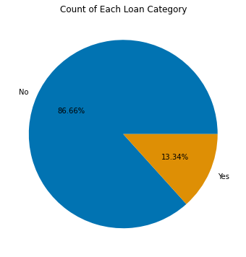

h) Loan Feature
Whether the customer has a loan or not.
df3[‘loan'].value_counts()
Majority of the customer had no loan with the bank.

Slide 32
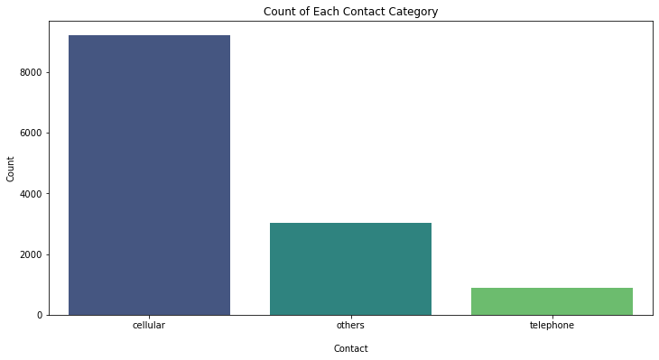

i) Contact Feature
Type of contact used to contact the customers
df['contact'].value_counts()
Majority of the customer were contacted through cellular/ mobile.

Slide 33
(j) Day and month Feature
Day and month when customers were last contacted
contacts were distributed across the days of the month but the campaign was more intensified in the month of May.

Slide 34
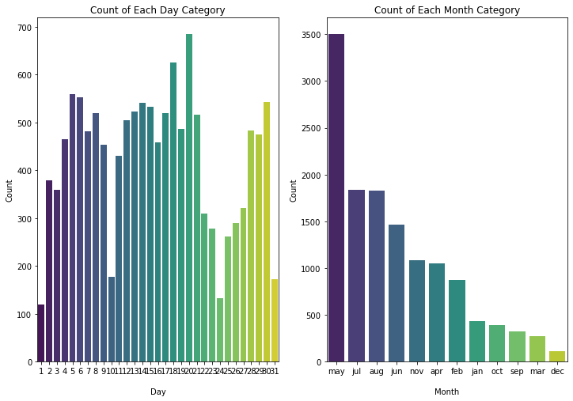

Slide 35
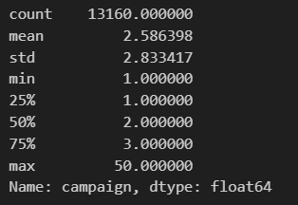
(k) Campaign Feature
Number of contacts performed during this campaign and for this client
df['campaign'].describe()

Slide 36
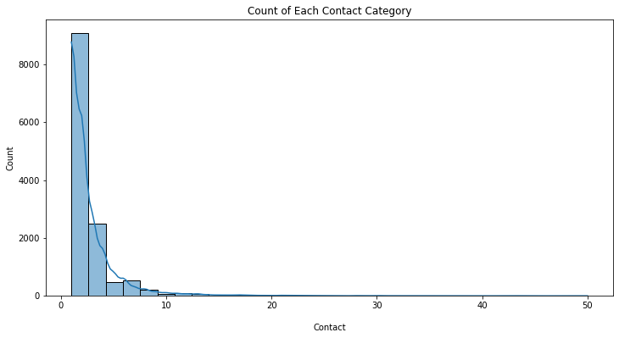
Majority of customers were contacted on once on the campaign.

Slide 37
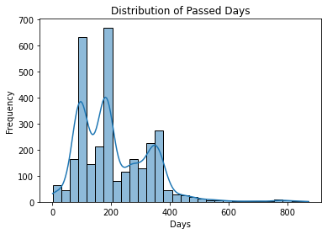
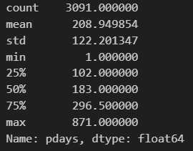
(l) Days passed before previous Campaign (pdays)
number days passed since previously contacted form previous campaign

Slide 38
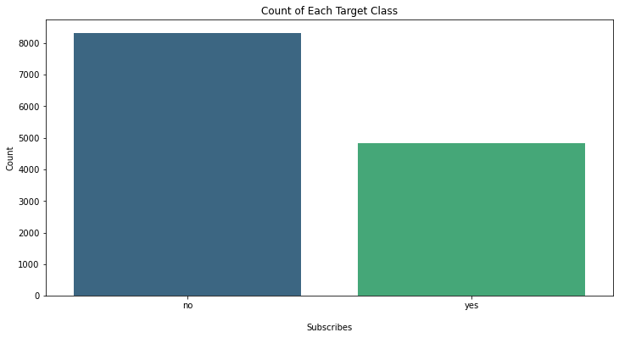

(m) Target field
Has the client subscribed a term deposit?
df['deposit'].value_counts()

Slide 39
4. Explore Correlations
To understand more about what features of these dataset to higher deposit, we look at some correlations.
In the cell below, we print out both the name of the column and the Pearson correlation for the column that is ***most positively correlated*** with `deposit` (other than `deposit`, which is perfectly correlated with itself).
using a heat map to show the correlation

Slide 40
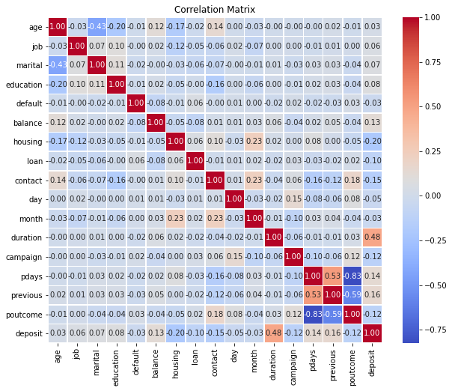

Slide 41
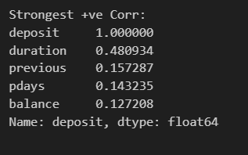
Most positively correlated
Duration is the most positively correlate feature with deposit.

Slide 42
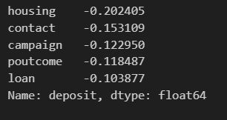
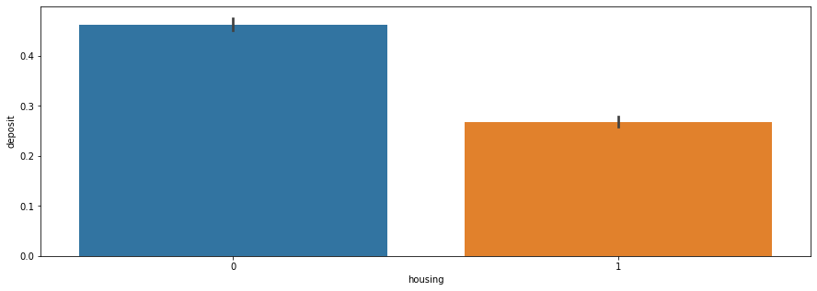
Most negatively correlated
housing is the most negatively correlate feature with deposit.

Slide 43
Conclusion:
In conclusion, Direct Marketing Campaigns for Bank Term Deposits play a crucial role in attracting and retaining customers, fostering long-term relationships, and boosting overall profitability for financial institutions. The ability to target specific audiences with personalized messages allows banks to communicate the value of term deposits effectively. Through the analysis of customer data and segmentation, direct marketing campaigns can be tailored to address the unique needs and preferences of different customer segments, thereby maximizing the chances of success.
Furthermore, the integration of digital channels, such as email marketing, social media, and targeted online advertising, has significantly enhanced the reach and efficiency of direct marketing efforts. These channels enable banks to engage with customers in real-time, delivering timely and relevant information about term deposit offerings.

Slide 44
Recommendation:
To enhance the effectiveness of Direct Marketing Campaigns for Bank Term Deposits, the following recommendations are proposed:
Multichannel Approach: Implement a multichannel approach that integrates traditional and digital marketing channels. This includes utilizing email marketing, social media, online advertising, and direct mail to reach a broader audience and reinforce the marketing message through various touchpoints.
Personalization: Continue to prioritize personalization in marketing messages. Customers respond positively to content that is tailored to their individual needs and interests. Utilize customer data to craft personalized offers and incentives that encourage them to consider and invest in bank term deposits.
Timely and Relevant Communication: Ensure that communication is timely and relevant. Keep customers informed about changes in interest rates, special promotions, and other relevant information. Automated systems can help in sending timely reminders and updates to maintain customer engagement.
Compliance and Transparency: Maintain a strong focus on compliance with regulatory requirements and ensure transparency in all communications. Customers appreciate clear and honest information about terms, conditions, and potential risks associated with term deposits.
Feedback and Continuous Improvement: Establish mechanisms for collecting customer feedback on marketing campaigns. Analyze the performance metrics and customer responses to identify areas for improvement. Implement a continuous improvement process to refine future campaigns based on insights gained.

Slide 45
END

